Slide 1
Lesson 1 Creating Controllers
BY
Aneesh Kumar

Slide 2
INDEX
INTRODUCTION OF EXPRESS API
PACKAGES WITH INSTALL COMMAND
CREATE JS FILES AND MAKE CONNECTION
USE POSTMAN FOR SEND REQUEST

Slide 3
INTRODUCTION OF EXPRESS API
EXPRESS API is a web API that use the RESTful approach.
REST API is a API that are use resource-based interfaces.
In EXPRESS API that use web resources that’s is formatted in JSON or XML file that accessed via HTTP represented by URL (Path).

Slide 4
Installing package
Install node module that are use to create application using npm install command
Express:- Express is a framework in express js
its provided various futures on web application.
For install express use npm i express

Slide 5
Install package and create application
Mongoose – mongoose provided database access for the local web site.
Its provided a schema that’s connect to mongo DB database .
For install mongoose use npm i mongoose

Slide 6
Install package and create application
Multer- it is use in node JS middleware multipart or form data which is primary used .
Its function that received the request and send response object when user create any type of request.
For install multer package we use the command
npm i multer.

Slide 7
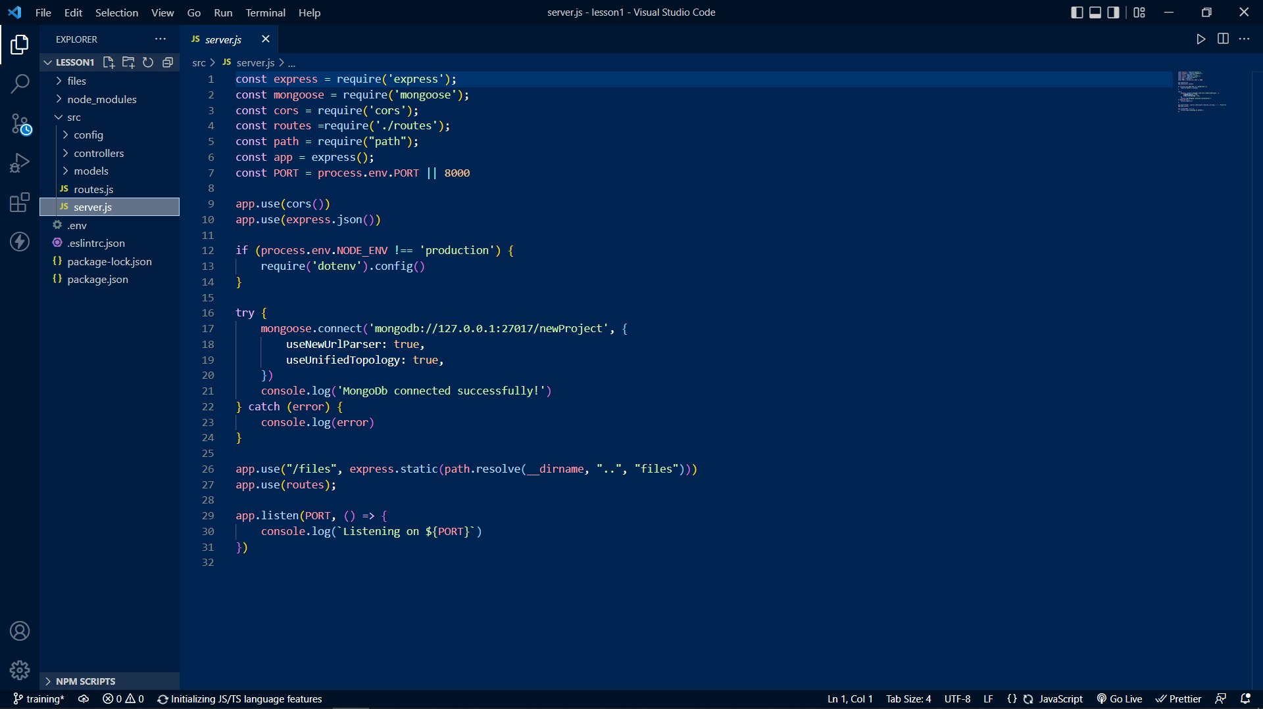
Create Server.js fle

Slide 8
Server.js file Explanations
It is the file that we use as a server file where we are make our connection.
In this file we are deploy our application in PORT 8000 .
In this file we are connect to our mongodb server with local .

Slide 9
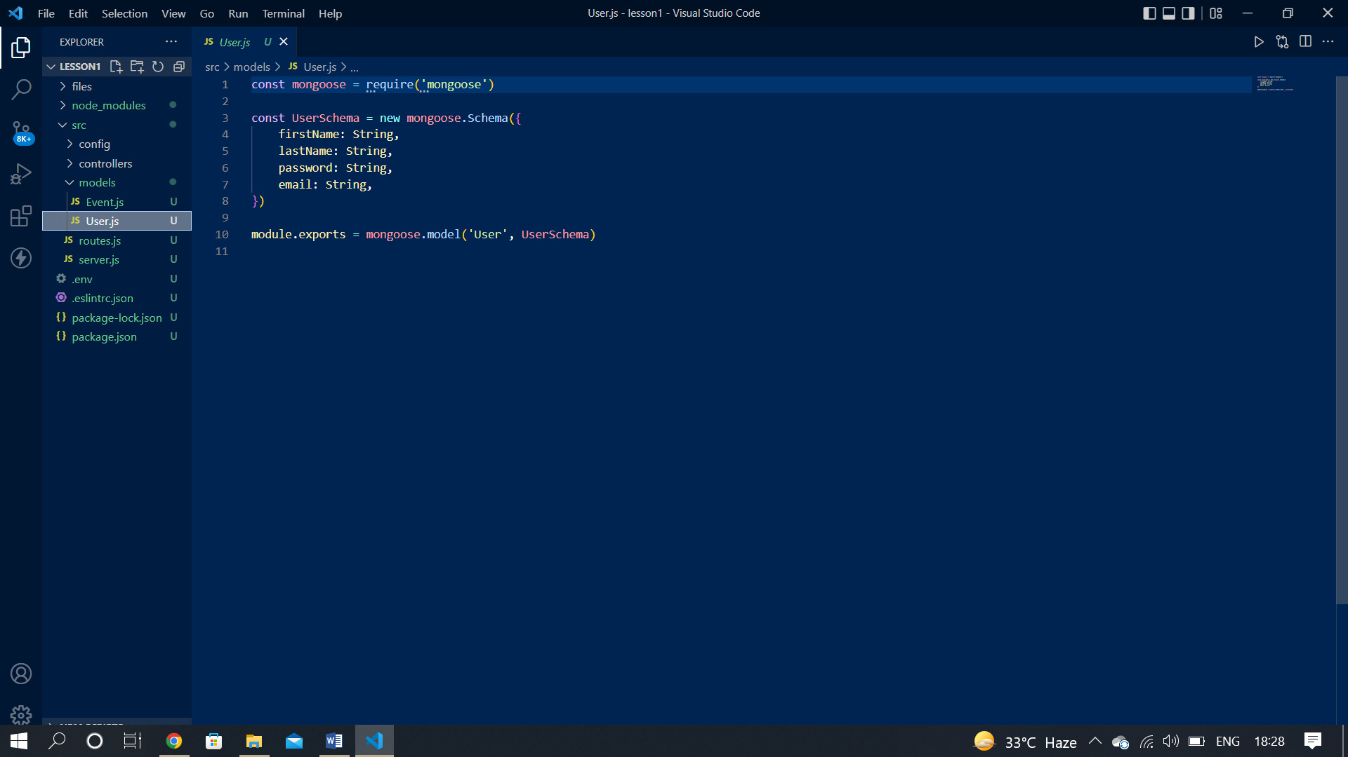
Create user.js file

Slide 10
User.js explanation
In the models folder we create User.js file .
In this file we are deploy mongoose that is use for create schema in mongodb server.
After that in this file we create our user schema like email firstName lastName.
After that we are export that other side .

Slide 11
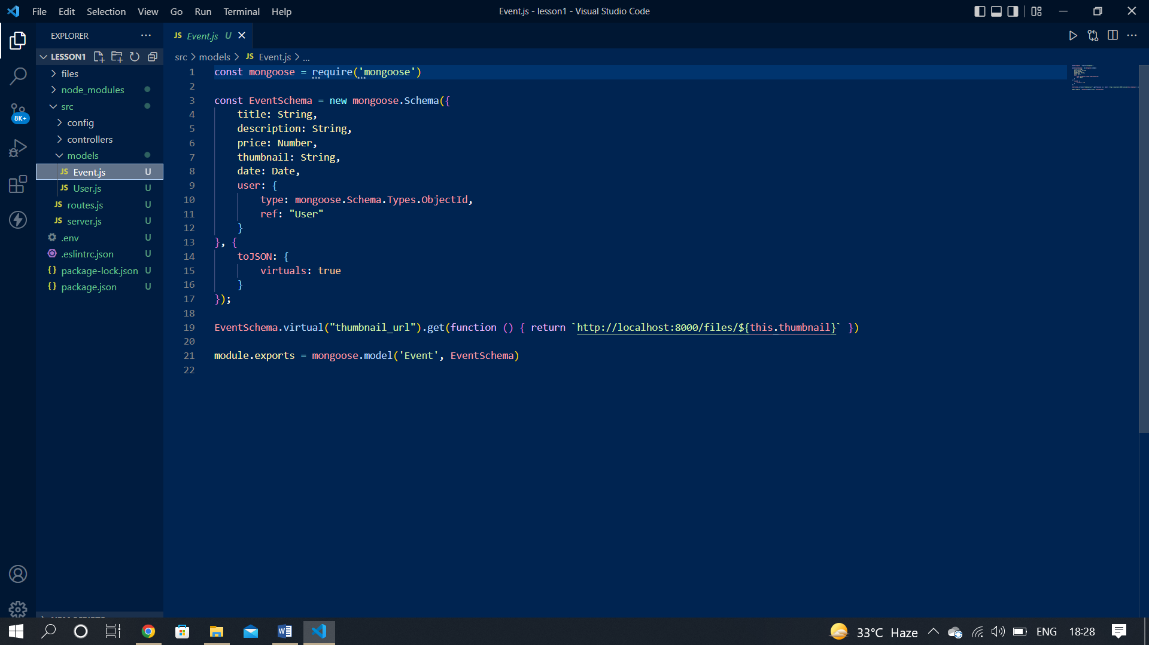
Create event.js

Slide 12
Event.js Explanation
In the Models folder another file name event.js
In this file we are deploy mongoose for create event schema
in the local we create local schema attributes like title ,date, thumbnail etc and all thous are take in strings .
After that we are export that make for event schma.

Slide 13
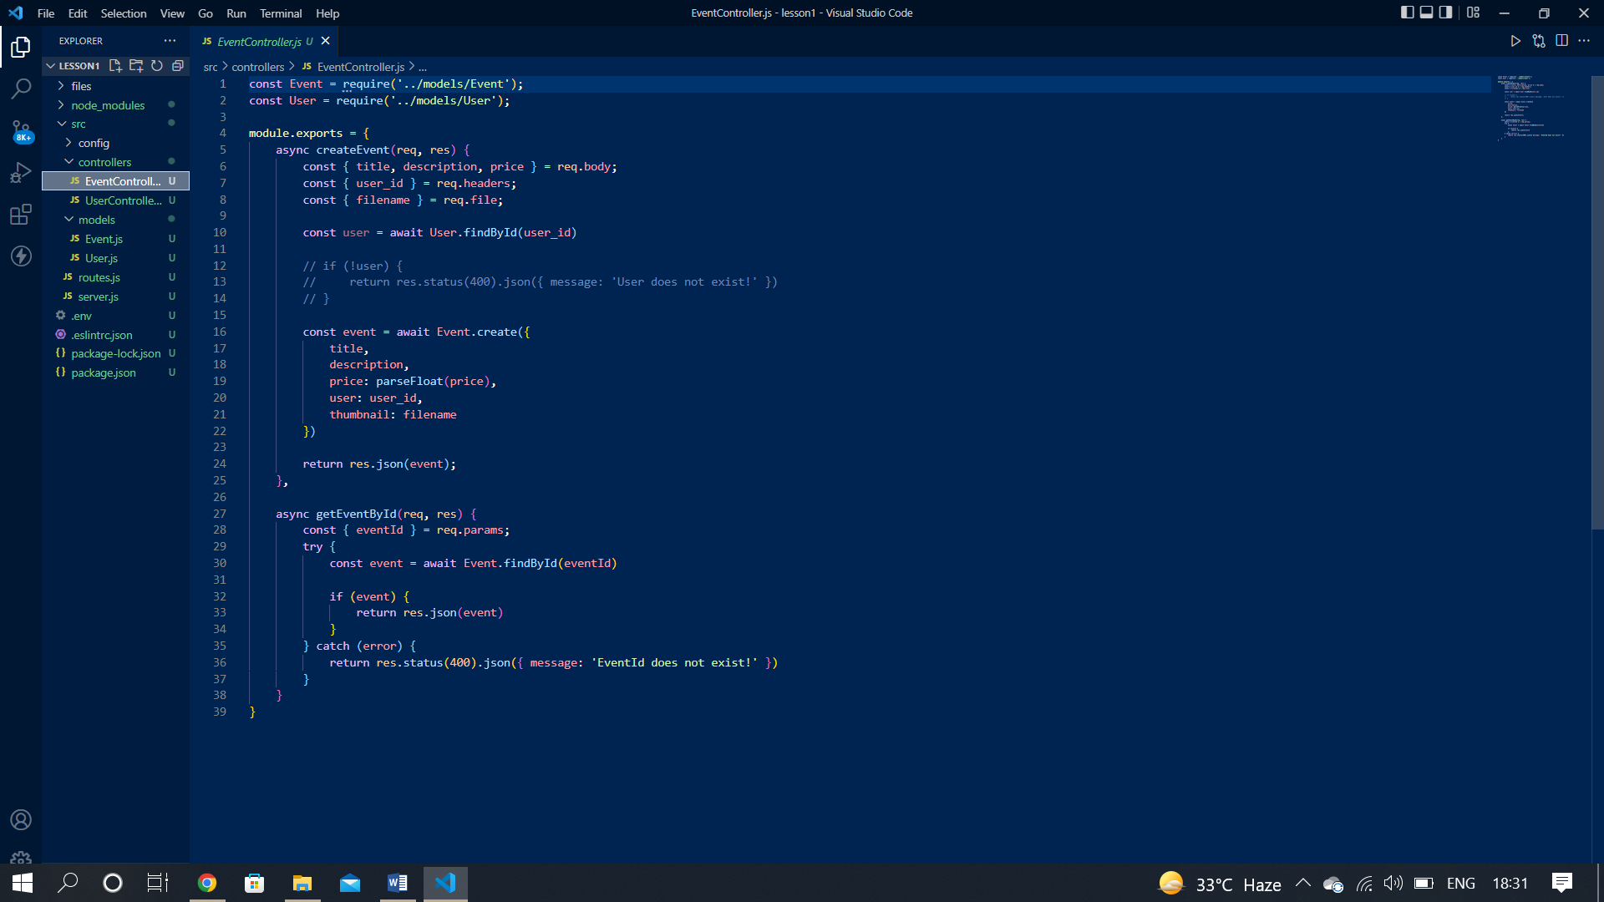
Create Eventcontroller.js file

Slide 14
Explanation of Eventcontroller.js
In the Eventcontroller.js file we are control or call event sub file.
First we create event to receive all the information form the request.
Then we apply findById() method to create user and check it using User_id.
If the user is exist then it create a event or if not exist then it show a massage user is not exist.

Slide 15
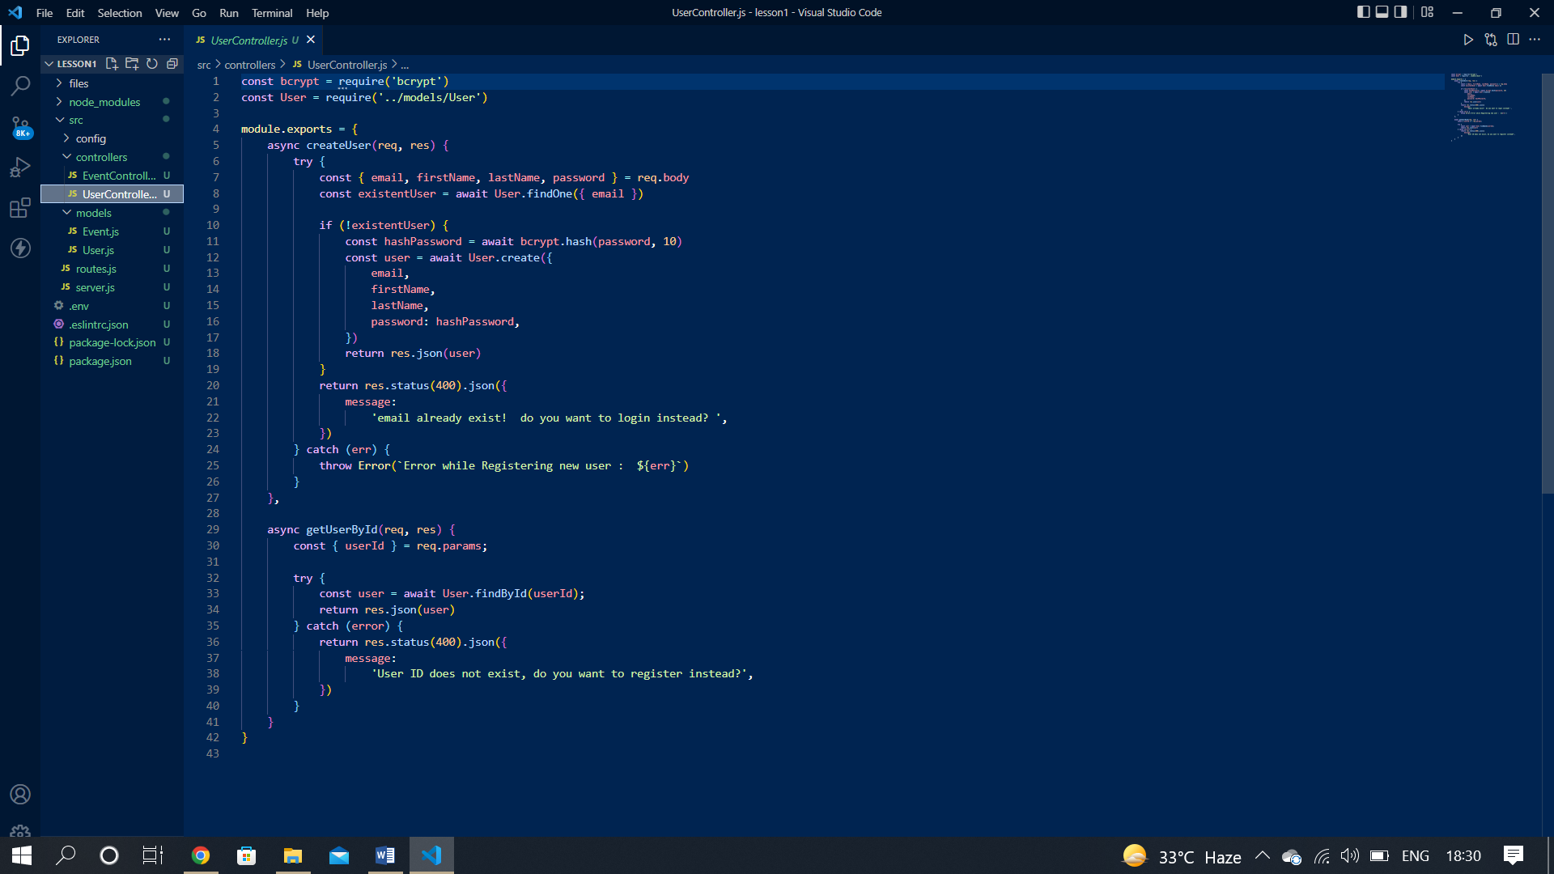
Create UserController.js

Slide 16
Explanation of UserController.js
In the UserController.js file we are control or call the user sub file.
First we export the module and fetch that user is exist on the database or not if exist then show a massage user is exist and if not exist then create a new user using user schema.
After that we use getUserById()method and use the User_id and fetch the user is exist on database or not if exist it show the result and not then 400 error massage show.

Slide 17
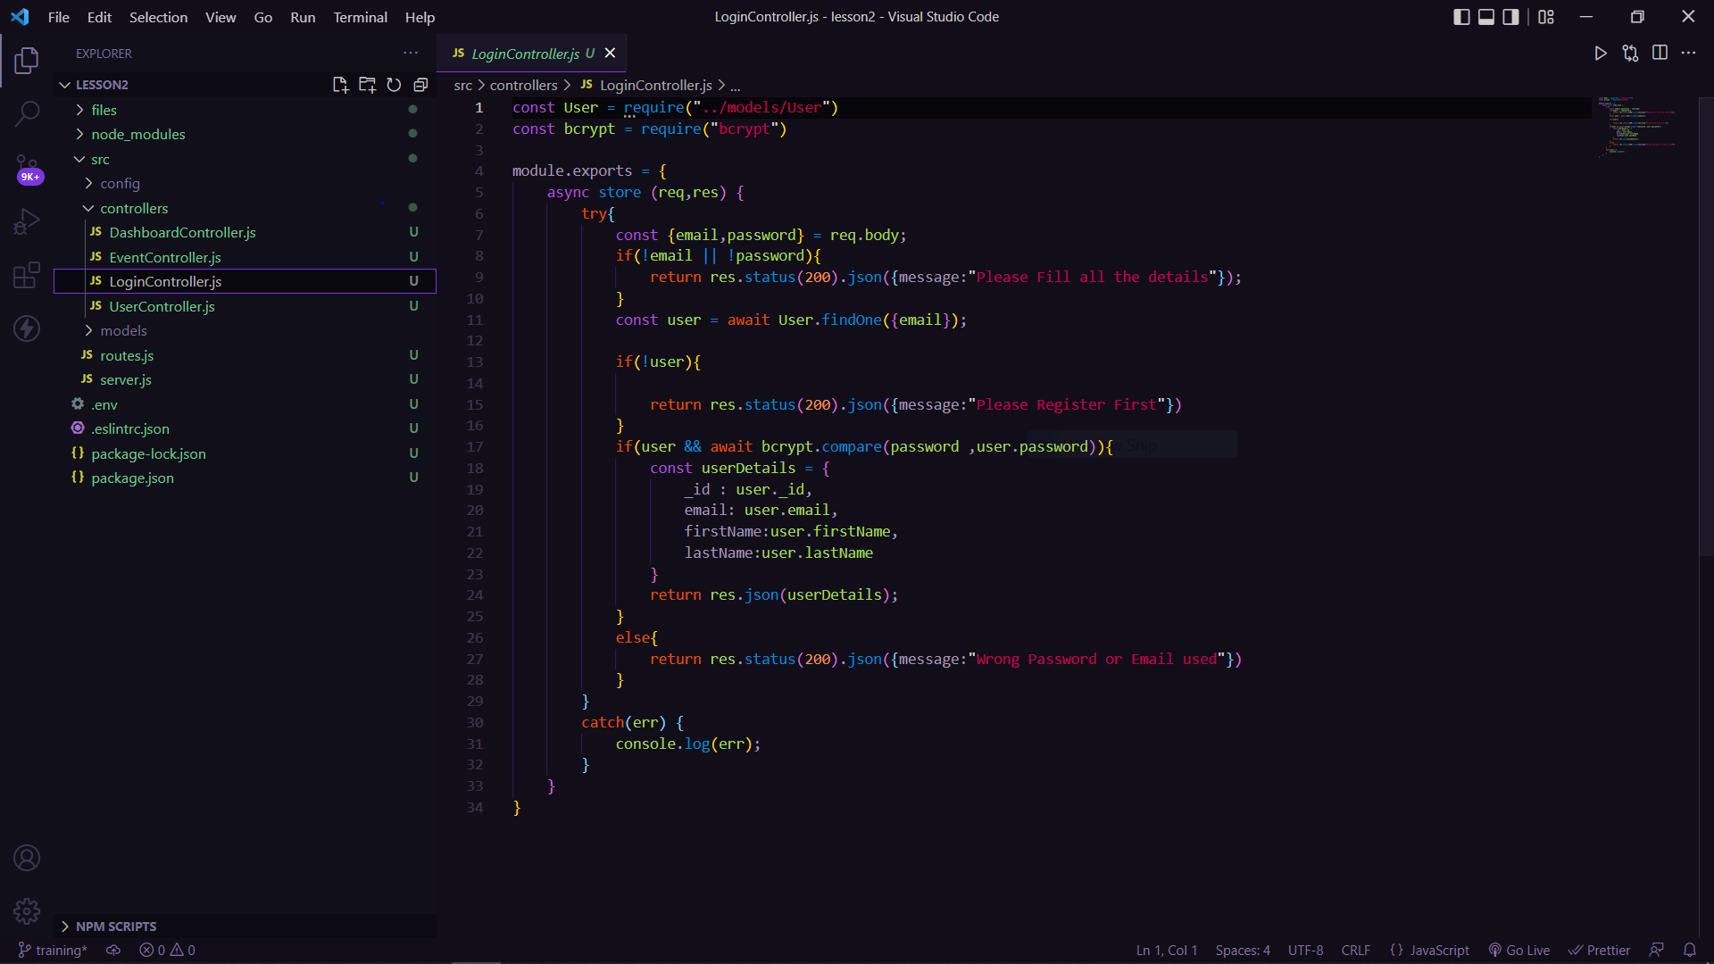
Create LoginController.js

Slide 18
Explanation of LoginController
In the LoginController.js file we are importing the User.js and bcrypt.
First we export the module and then we take email and password as input from body and compare with the database.
If the user details matches with the database we give all details as res or if there is any error we give that err as response.

Slide 19
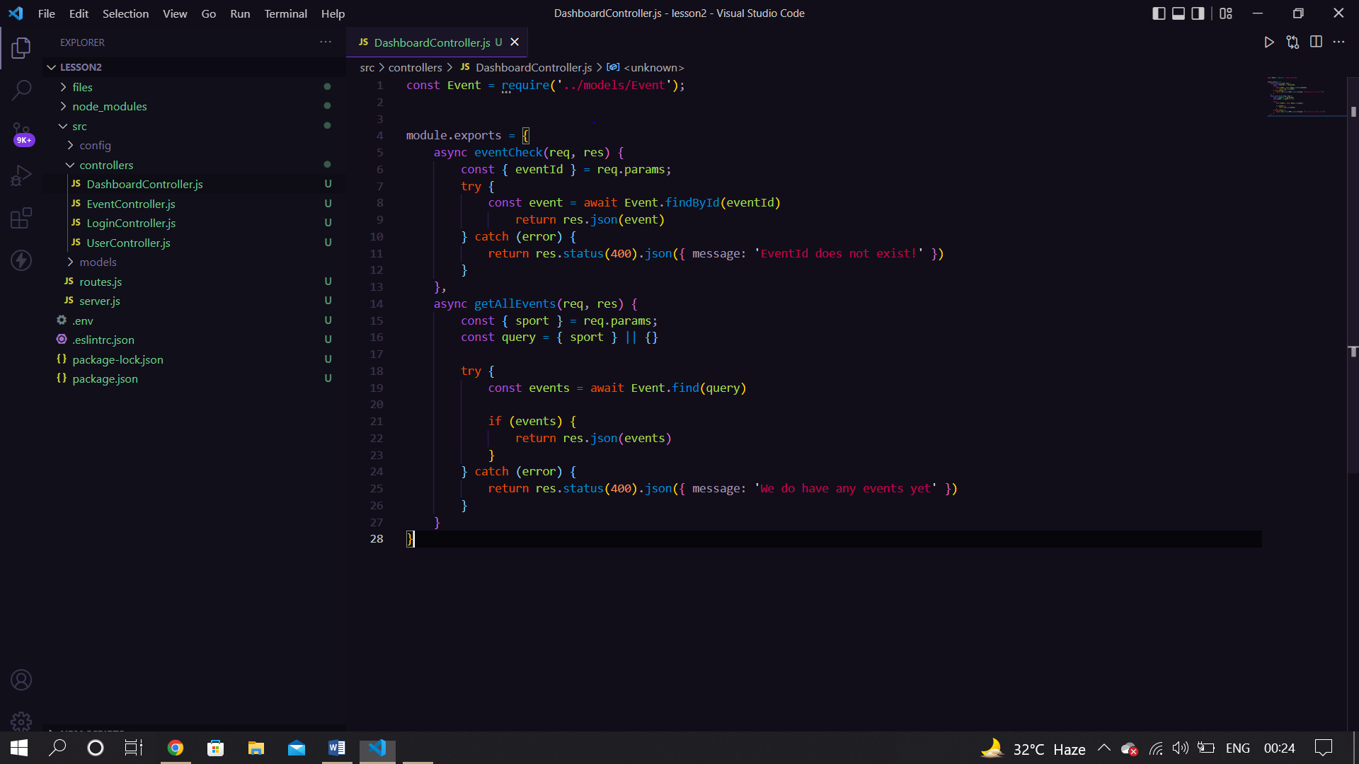
Create DashboardController.js

Slide 20
Explanation of DashboardController.js
In the DashboradController.js file we are importing the Event.js file .
First we export the module and then we have two controllers eventcheck and getAllEvent.
In first we are finding an event by corresponding id and in second we are finding the event based on a specific sport.

Slide 21
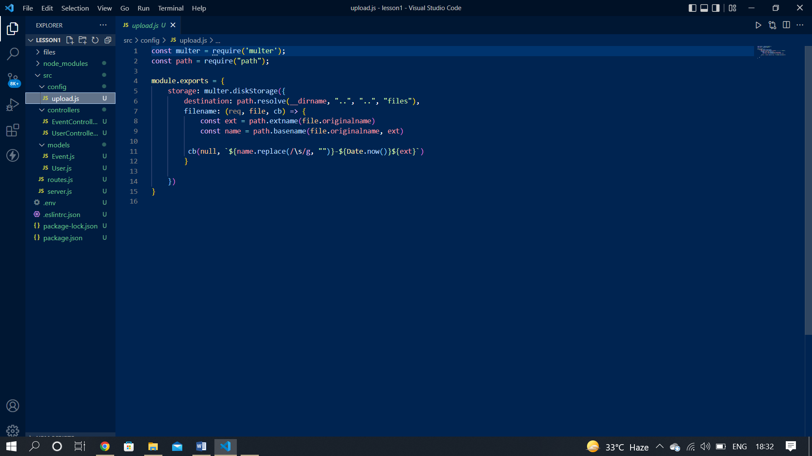
Create upload.js

Slide 22
Explanation of Upload.js
In the upload.js file we construct the file path
First we construct the path and then storage in local and make and url
After that its back to controller with file extension.
If that file had any rejection then its show error massage using controller file.

Slide 23
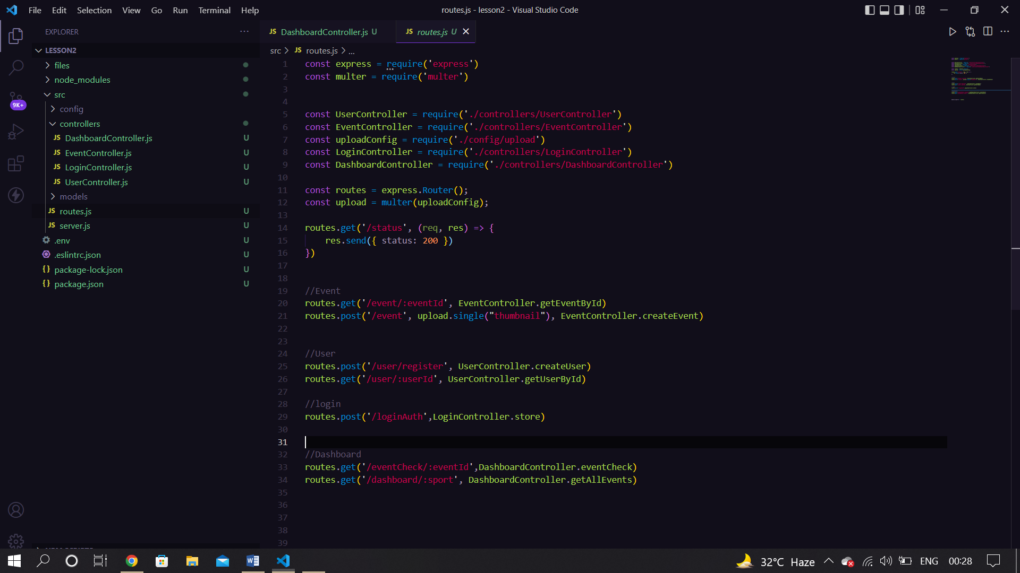
Create routes.js

Slide 24
Explanation of routes.js
In the routes.js file we are connected all the middleware that are routes of the main file .
And also create the user and event routes that we call through an API.

Slide 25
Use Postman to check request
How we use POSTMAN
Step 1:- Go to the collection tab click on the ‘+’ button create a new collection it will appear name or other setting.
Step 2:- Then select create a new request and it will open a window on post man application like this.
Step 3 :- Set the address of your local host and add the request type get and check the result. If it shows status code 200 in green then it is ok.
Step 4 - Set post request and put the value and check the status if it show 200 then it’s ok or if show 404 then error is process.

Slide 26
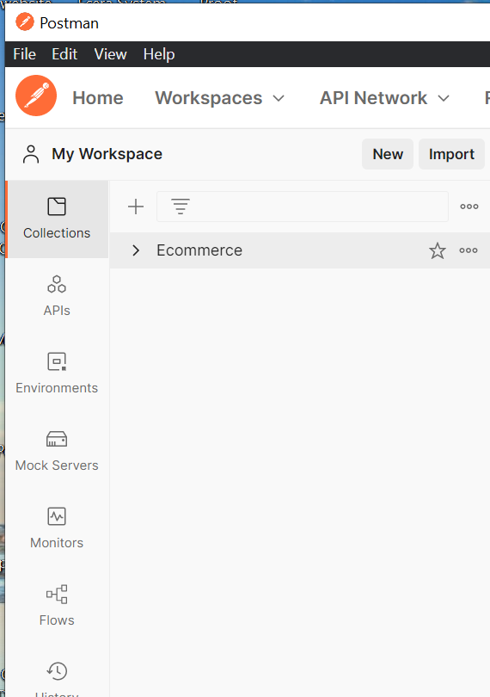
Process step of postman

Slide 27
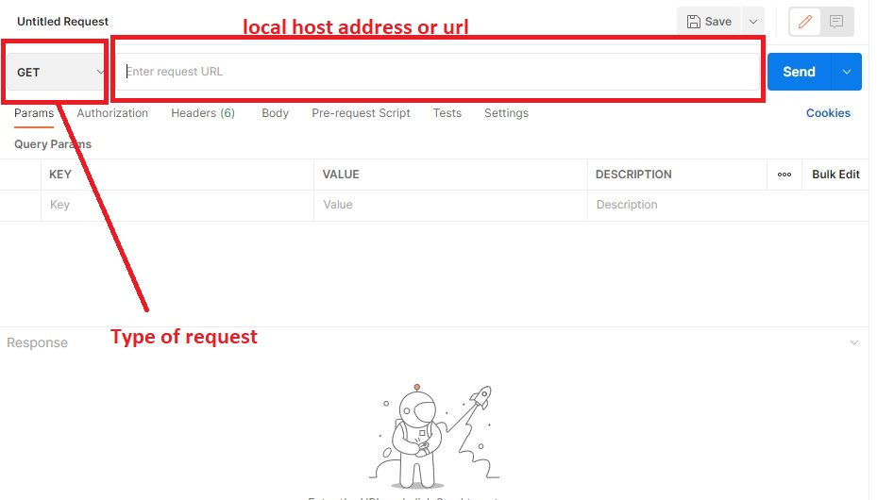
Process step of postman

Slide 28
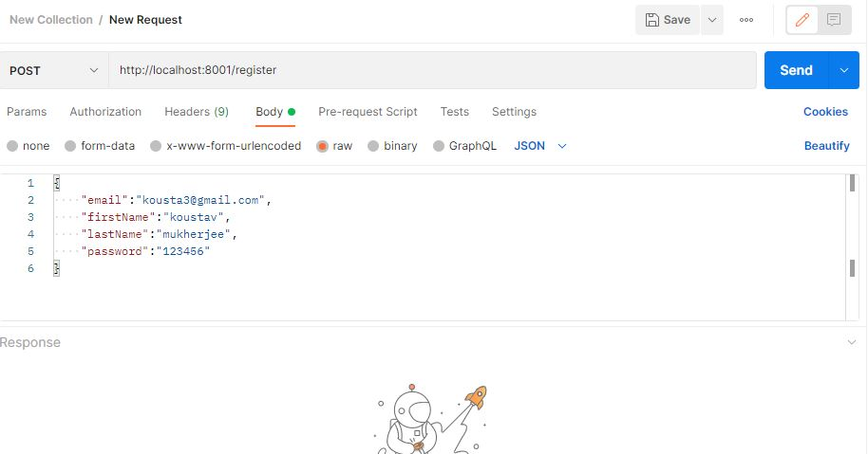
Process step of postman using register

Slide 29
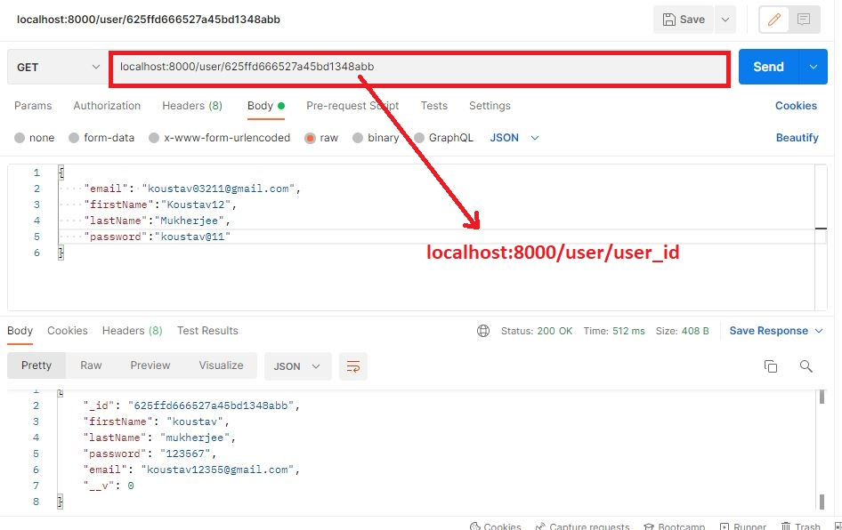
Process step to fetch data using get method by user_id

Slide 30
Create an event using postman
Step 1-> select method POST and add url
Step 2-> Go to body and select form-data and fill-up all data like title, date, description it is fill as text and select and filled like thumbnail change it to text to file from the postman hidden button and after that select the file.
Step 3 -> go to send button to send the request.
Step 4 -> change the request GET and then search a event by event _ id .

Slide 31
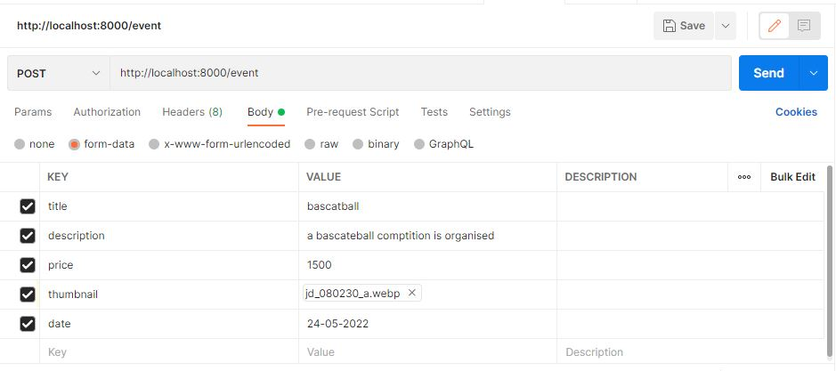
Process step of postman using event

Slide 32
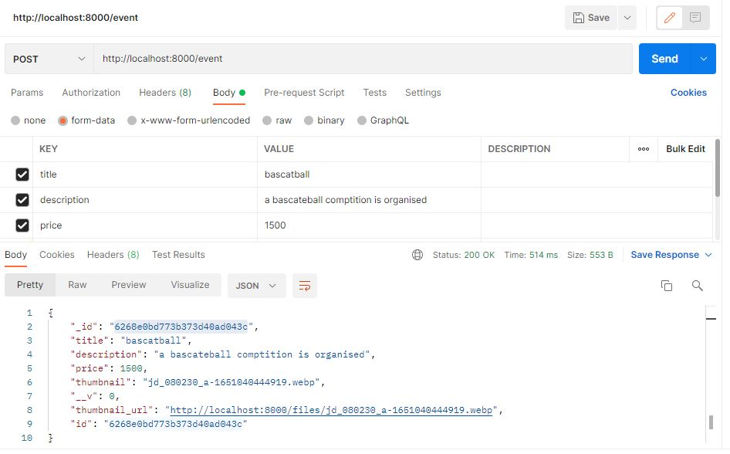
Process step of postman using event(click on send button and see result

Slide 33
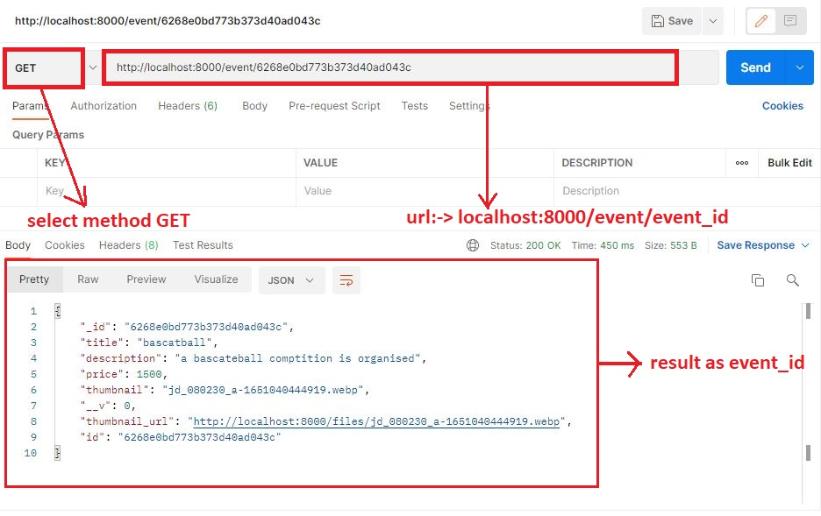
Process step to fetch data using get method by event_id

Slide 34
Thank You

